Slide 1
Chapter 17
Security at the
Transport Layer:
SSL and TLS
17.<number>

Slide 2
Chapter 17
Objectives
❏ To discuss the need for security services at the transport layer of the Internet model
❏ To discuss the general architecture of SSL
❏ To discuss the general architecture of TLS
❏ To compare and contrast SSL and TLS
17.<number>

Slide 3
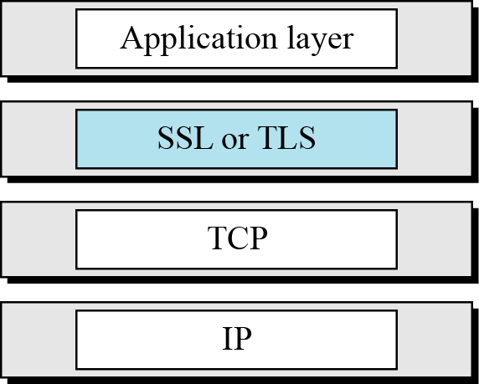
17 Continued
Figure 17.1 Location of SSL and TLS in the Internet model
17.<number>

Slide 4
Supported Operating systems tabulated below:
Windows OS Version | SSL 2.0 | SSL 3.0 | TLS 1.0 | TLS 1.1 | TLS 1.2
Windows XP & Windows Server 2003 | ✔ | ✔ | ✔ | X | X
Windows Vista & Windows Server 2008 | ✔ | ✔ | ✔ | ✔ | ✔
Windows 7 & Windows Server 2008 R2 | ✔ | ✔ | ✔ | ✔ | ✔
Windows 8 & Windows Server 2012 | ✔ | ✔ | ✔ | ✔ | ✔
Windows 8.1 & Windows Server 2012 R2 | ✔ | ✔ | ✔ | ✔ | ✔
Windows 10 & Windows Server 2016 | ✔ | ✔ | ✔ | ✔ | ✔
17.<number>

Slide 5
17-1 SSL ARCHITECTURE
SSL is designed to provide security and compression services to data generated from the application layer.
Topics discussed in this section:
17.1.1 Services
17.1.2 Key Exchange Algorithms
17.1.3 Encryption/Decryption Alogrithms
17.1.4 Hash Algorithms
17.1.5 Cipher Suite
17.1.6 Compression Algorithms
17.1.7 Crypography Parameter Generation
17.1.8 Session and Connections
17.<number>

Slide 6
17.1.1 Services
Fragmentation
SSL divides, Blocks of 2¹⁴ bytes
Compression
Message Integrity
Confidentiality
Framing
17.<number>

Slide 7
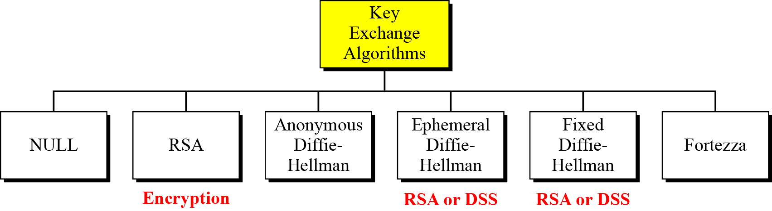
17.1.2 Key Exchange Algorithms
Figure 17.2 Key-exchange methods
17.<number>

Slide 8

17.1.2 Continued
Null
There is no key exchange in this method. No pre-master secret is established between the client and the server.
Note
Both client and server need to know the value of the pre-master secret.
17.<number>

Slide 9
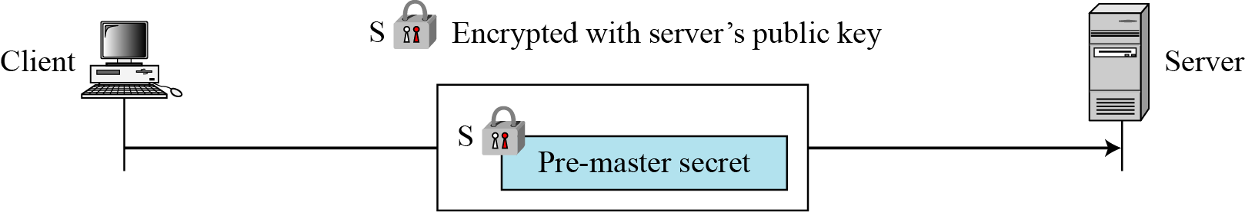
17.1.2 Continued
RSA
Figure 17.3 RSA key exchange; server public key
17.<number>

Slide 10
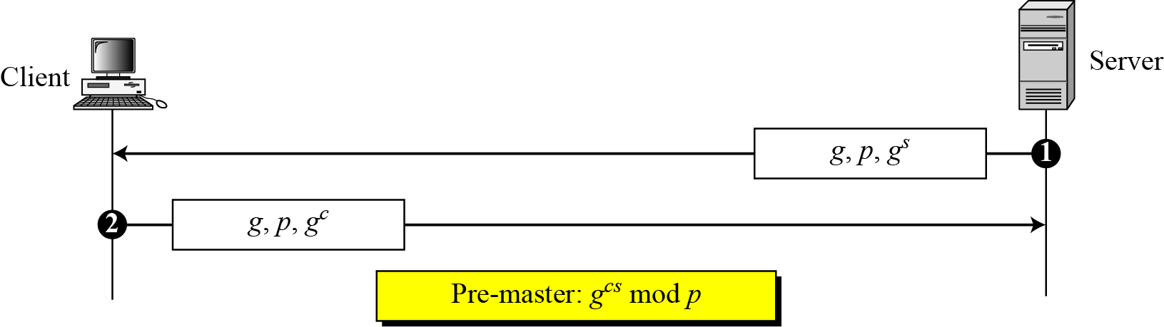
17.1.2 Continued
Anonymous Diffie-Hellman
Figure 17.4 Anonymous Diffie-Hellman key exchange
17.<number>

Slide 11
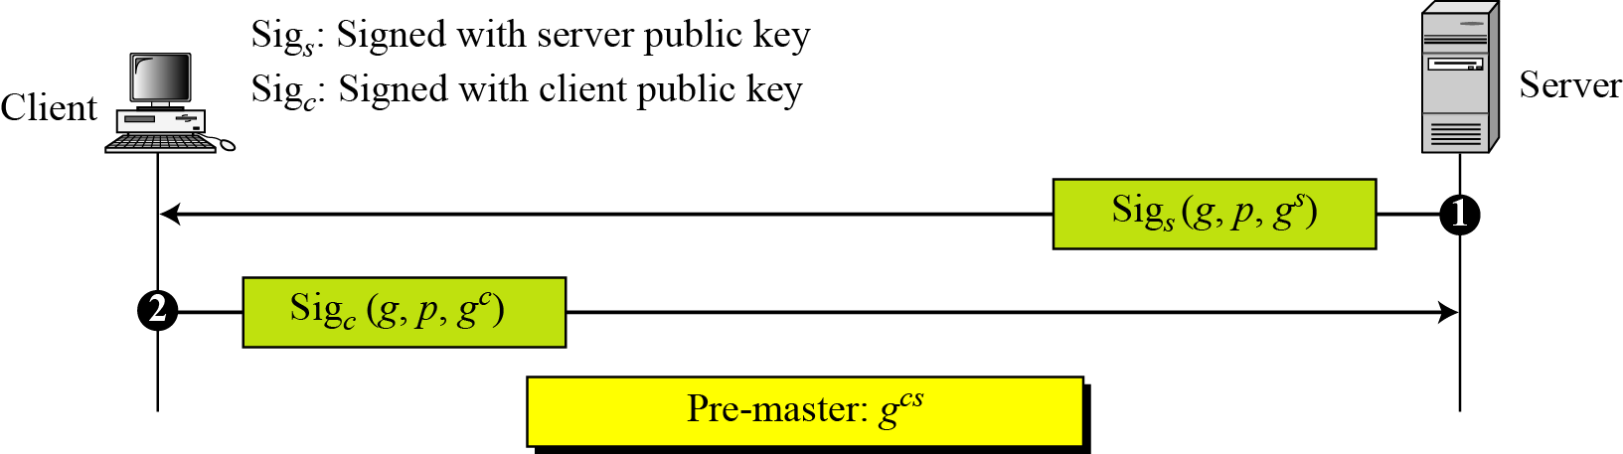
17.1.2 Continued
Ephemeral Diffie-Hellman key exchange
Figure 17.5 Ephemeral Diffie-Hellman key exchange
17.<number>

Slide 12
17.1.2 Continued
Fixed Diffie-Hellman
Another solution is the fixed Diffie-Hellman method. All entities in a group can prepare fixed Diffie-Hellman parameters (g and p).
Fortezza
Fortezza is a registered trademark of the U.S. National Security Agency (NSA). It is a family of security protocols developed for the Defense Department.
17.<number>

Slide 13
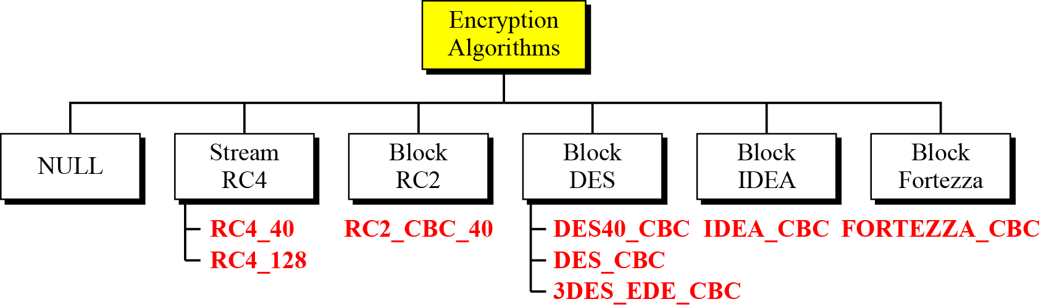
17.1.3 Encryption/Decryption Algorithms
Figure 17.6 Encryption/decryption algorithms
17.<number>

Slide 14
17.1.3 Continued
NULL
The NULL category simply defines the lack of an encryption/decryption algorithm.
Stream RC
Two RC algorithms are defined in stream mode.
Block RC
One RC algorithm is defined in block mode.
DES
All DES algorithms are defined in block mode.
17.<number>

Slide 15
17.1.3 Continued
IDEA
The IDEA algorithm defined in block mode is IDEA_CBC, with a 128-bit key.
Fortezza
The one Fortezza algorithm defined in block mode is FORTEZZA_CBC.
17.<number>

Slide 16
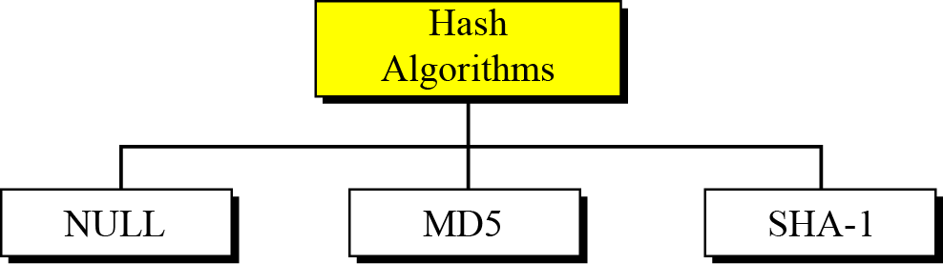
17.1.4 Hash Algorithm
Figure 17.7 Hash algorithms for message integrity
17.<number>

Slide 17
17.1.4 Continued
NULL
The two parties may decline to use an algorithm. In this case, there is no hash function and the message is not authenticated.
MD5
The two parties may choose MD5 as the hash algorithm. In this case, a 128-key MD5 hash algorithm is used.
SHA-1
The two parties may choose SHA as the hash algorithm. In this case, a 160-bit SHA-1 hash algorithm is used.
17.<number>

Slide 18

17.1.5 Cipher Suite
The combination of key exchange, hash, and encryption algorithms defines a cipher suite for each SSL session.
17.<number>

Slide 19
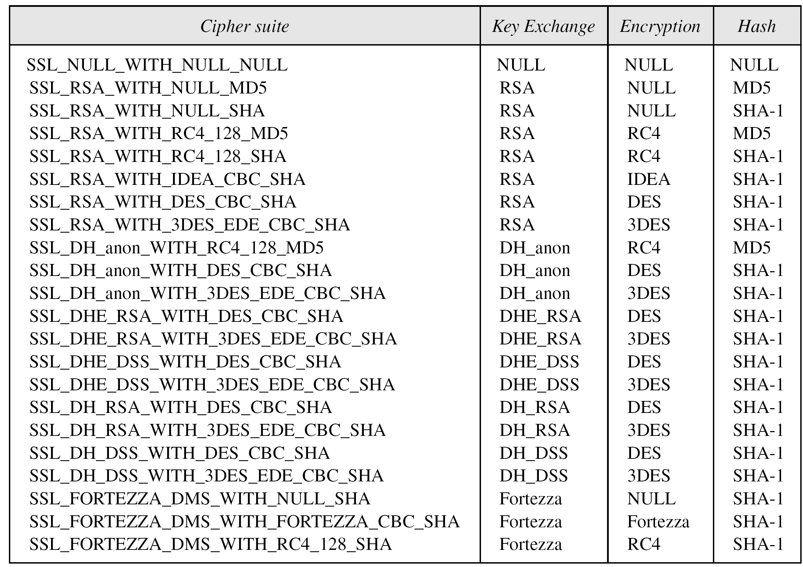
17.1.5 Continued
Table 17.1 SSL cipher suite list
17.<number>

Slide 20
17.1.6 Compression Algorithms
Compression is optional in SSLv3.
No specific compression algorithm is defined for SSLv3. Therefore, the default compression method is NULL.
17.<number>

Slide 21
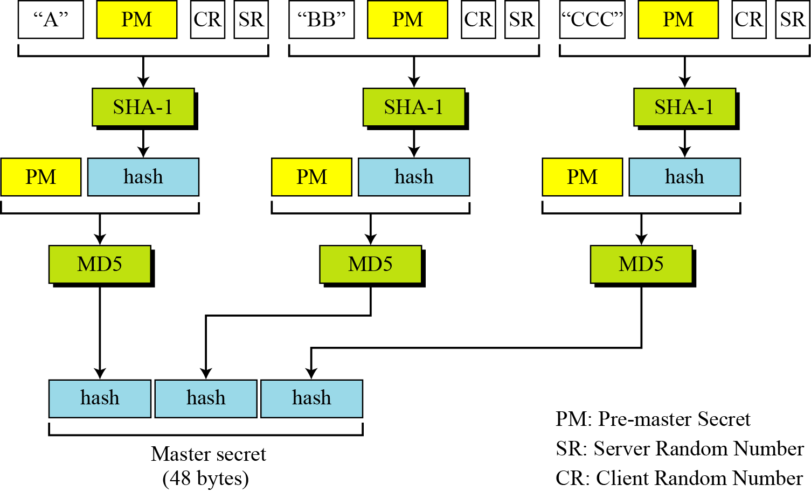
17.1.7 Cryptographic Parameter Generation
Figure 17.8 Calculation of master secret from pre-master secret
17.<number>

Slide 22
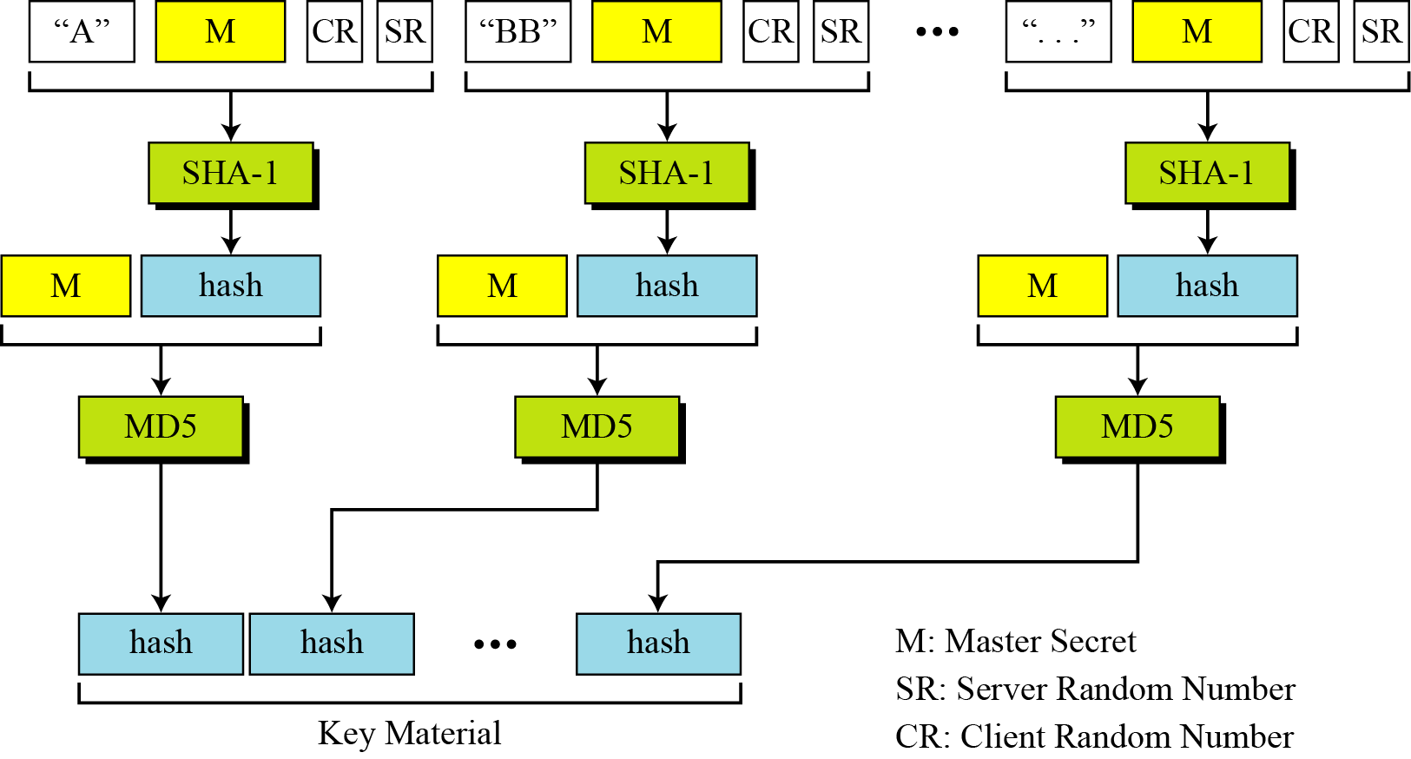
17.1.7 Continued
Figure 17.9 Calculation of key material from master secret
17.<number>

Slide 23
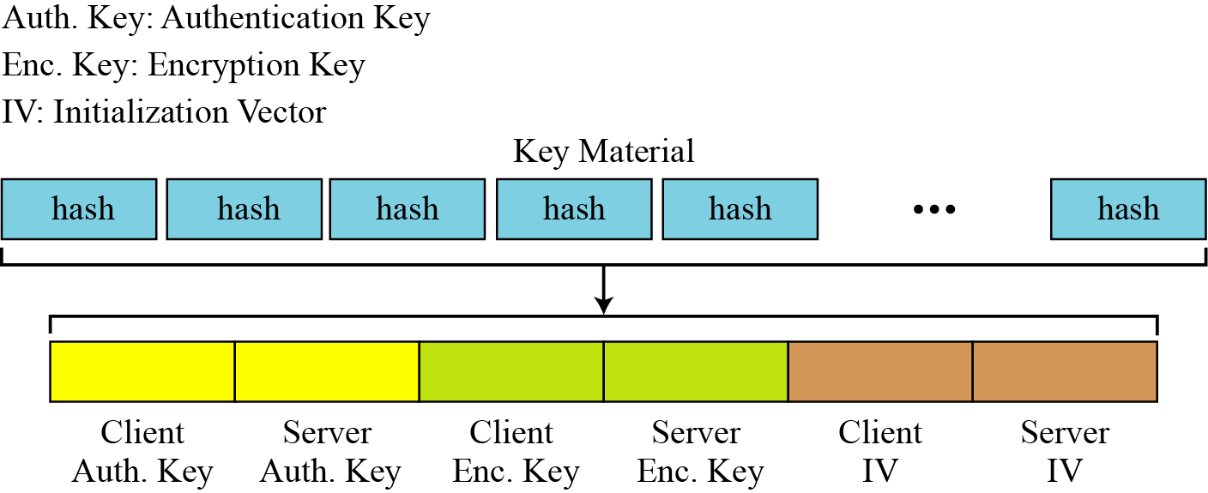
17.1.7 Continued
Figure 17.10 Extractions of cryptographic secrets from key material
17.<number>

Slide 24
17.1.8 Sessions and Connections
Note
In a session, one party has the role of a client and the other the role of a server;
in a connection, both parties have equal roles, they are peers.
17.<number>

Slide 25
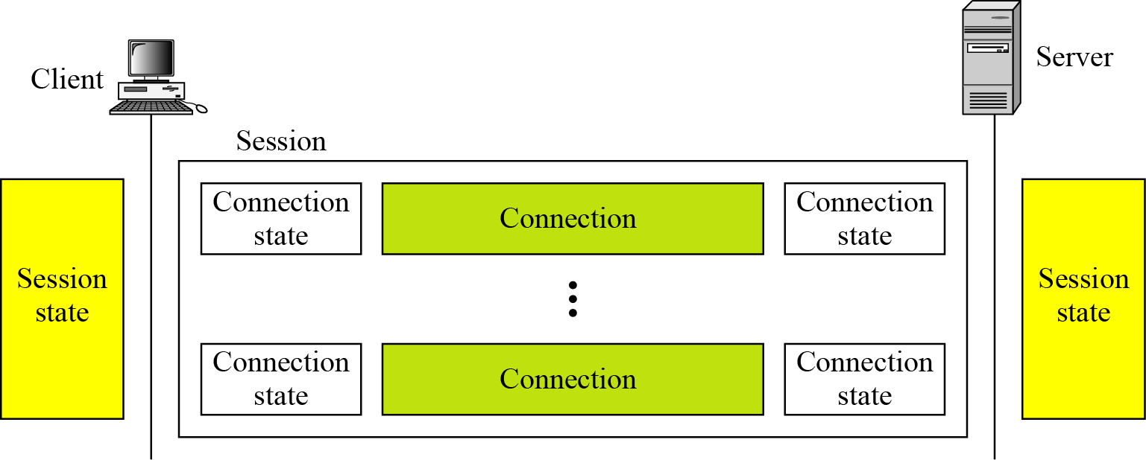
17.1.8 Continued
Figure 17.11 A session and connections
17.<number>

Slide 26
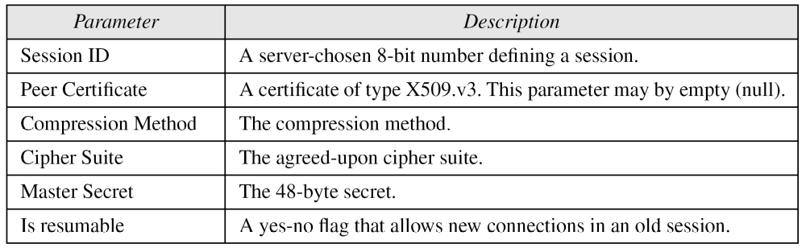
17.1.8 Continued
Session State
Table 17.2 Session state parameters
17.<number>

Slide 27
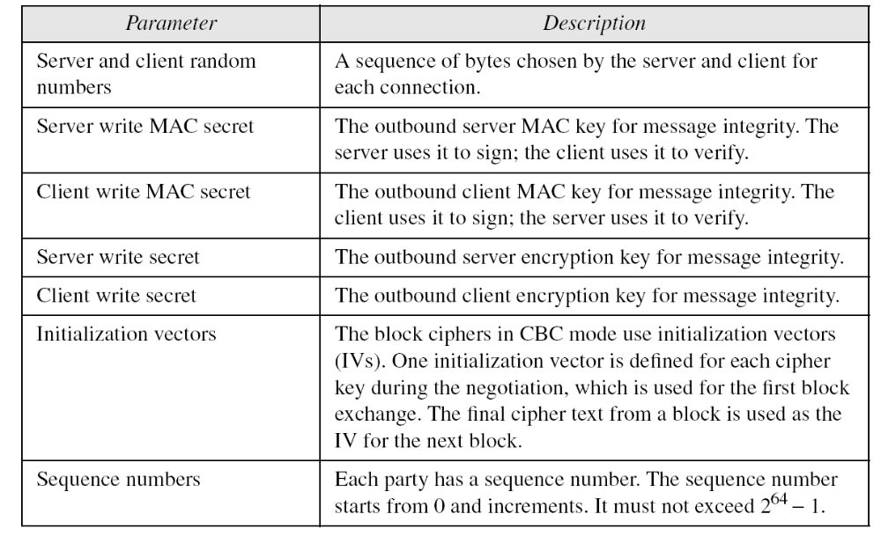
17.1.8 Continued
Connection State
Table 17.3 Connection state parameters
17.<number>

Slide 28
17.1.8 Continued
Note
The client and the server have six different cryptography secrets: three read secrets
and three write secrets.
The read secrets for the client are the same as the write secrets for the server and vice versa.
17.<number>

Slide 29
17-2 Four Protocols
We have discussed the idea of SSL without showing how SSL accomplishes its tasks. SSL defines four protocols in two layers, as shown in Figure 17.12.
Topics discussed in this section:
17.2.1 Handshake Protocol
17.2.2 ChangeCipher Spec Protocol
17.2.3 Alert Protocol
17.2.4 Record Protocol
17.<number>

Slide 30
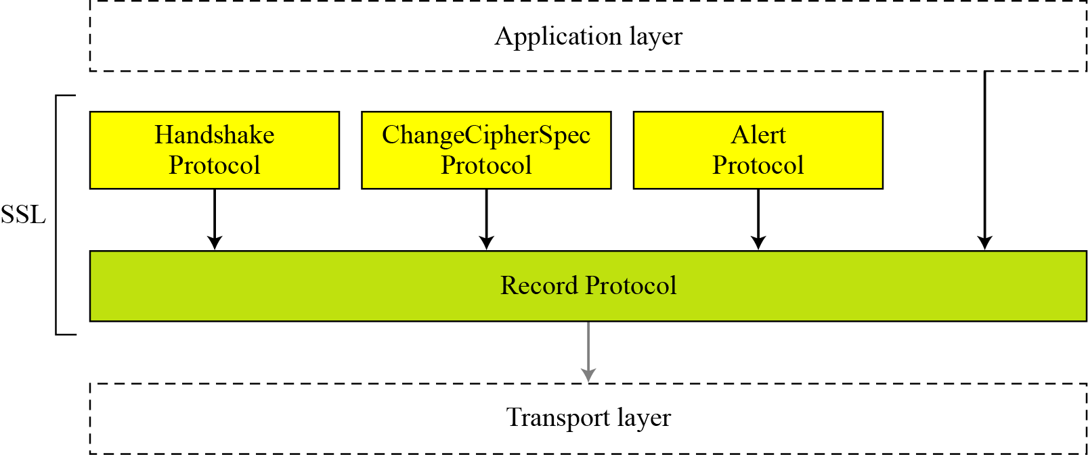
17.2. Continued
Figure 17.12 Four SSL protocols
17.<number>

Slide 31
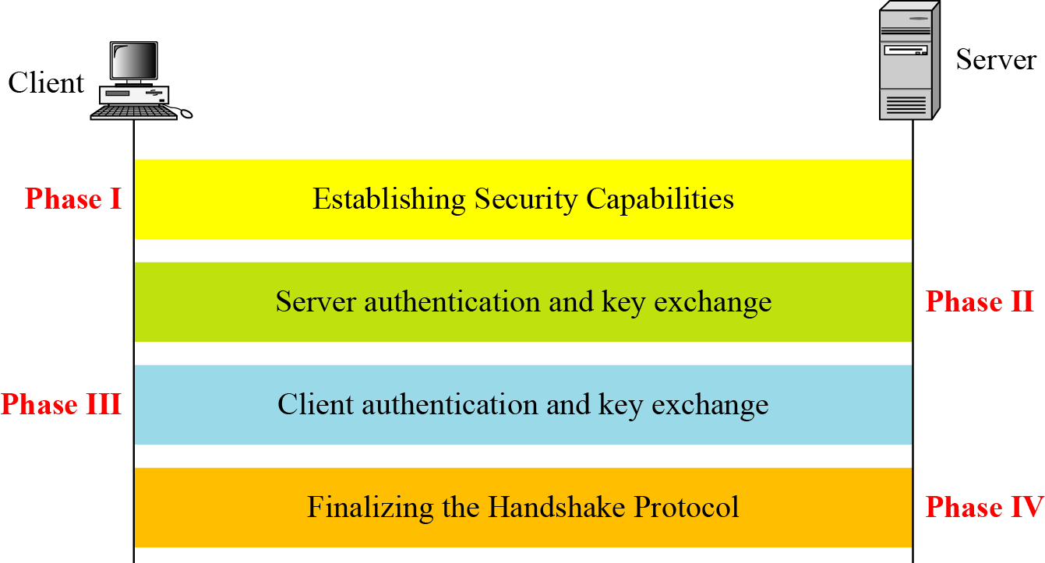
17.2.1 Handshake Protocol
Figure 17.13 Handshake Protocol
17.<number>

Slide 32
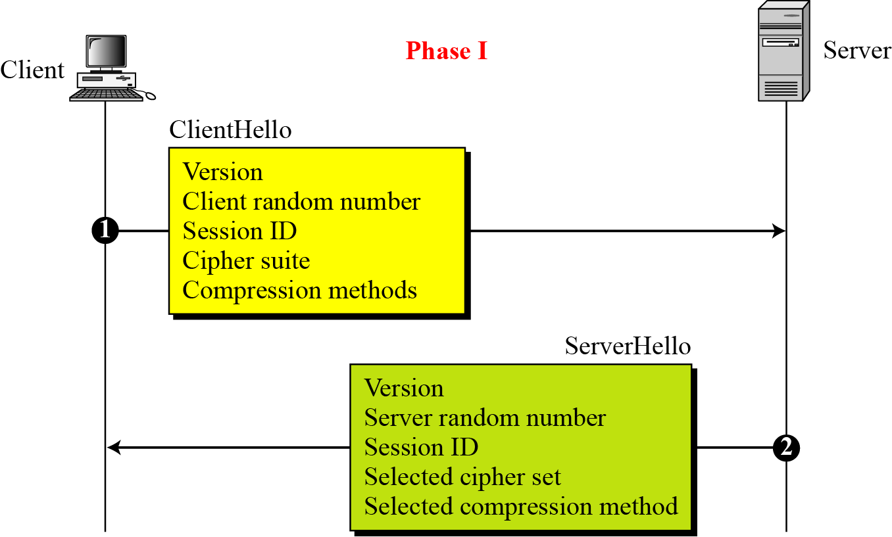
17.2.1 Continued
Figure 17.14 Phase I of Handshake Protocol
17.<number>

Slide 33
17.2.1 Continued
Note
After Phase I, the client and server know the following:
❏ The version of SSL
❏ The algorithms for key exchange, message
authentication, and encryption
❏ The compression method
❏ The two random numbers for key
generation
17.<number>

Slide 34
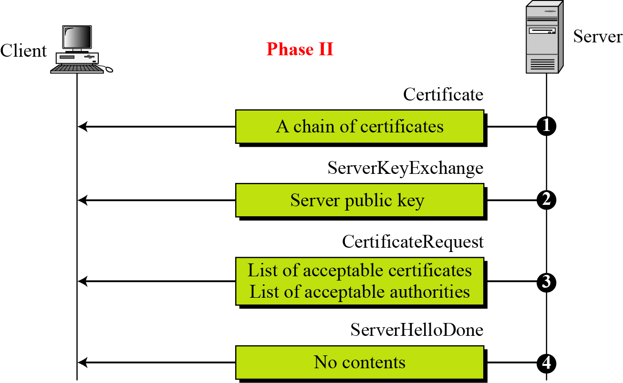
17.2.1 Continued
Figure 17.15 Phase II of Handshake Protocol
17.<number>

Slide 35
17.2.1 Continued
Note
After Phase II,
❏ The server is authenticated to the client.
❏ The client knows the public key of the
server if required.
17.<number>

Slide 36
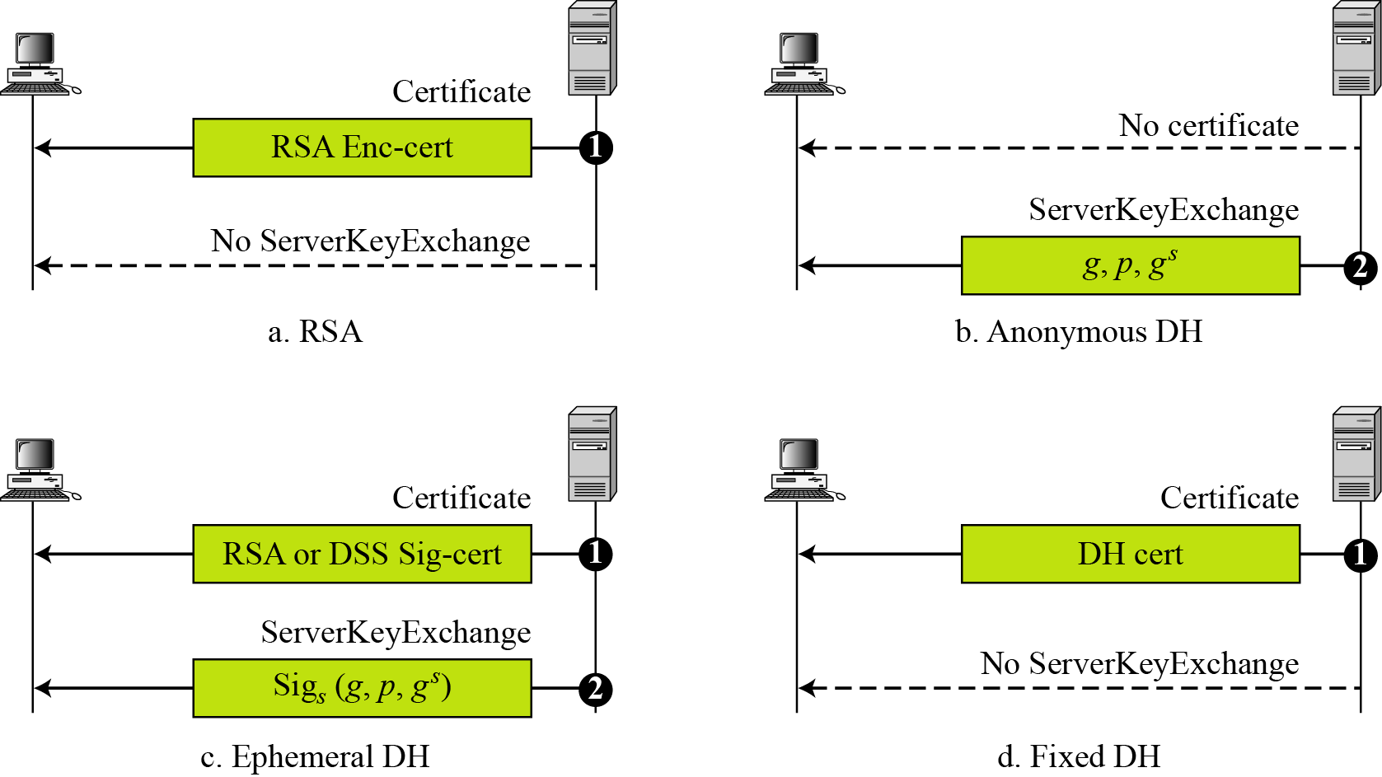
17.2.1 Continued
Figure 17.16 Four cases in Phase II
17.<number>

Slide 37
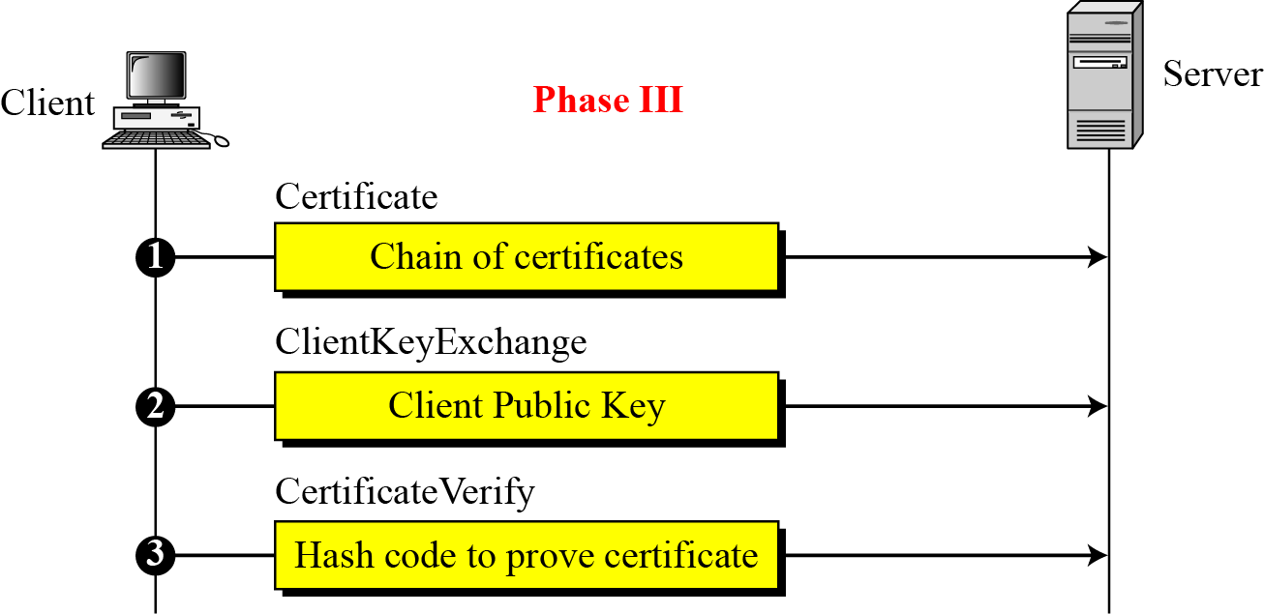
17.2.1 Continued
Figure 17.17 Phase III of Handshake Protocol
17.<number>

Slide 38
17.2.1 Continued
Note
After Phase III,
❏ The client is authenticated for the server.
❏ Both the client and the server know the
pre-master secret.
17.<number>

Slide 39
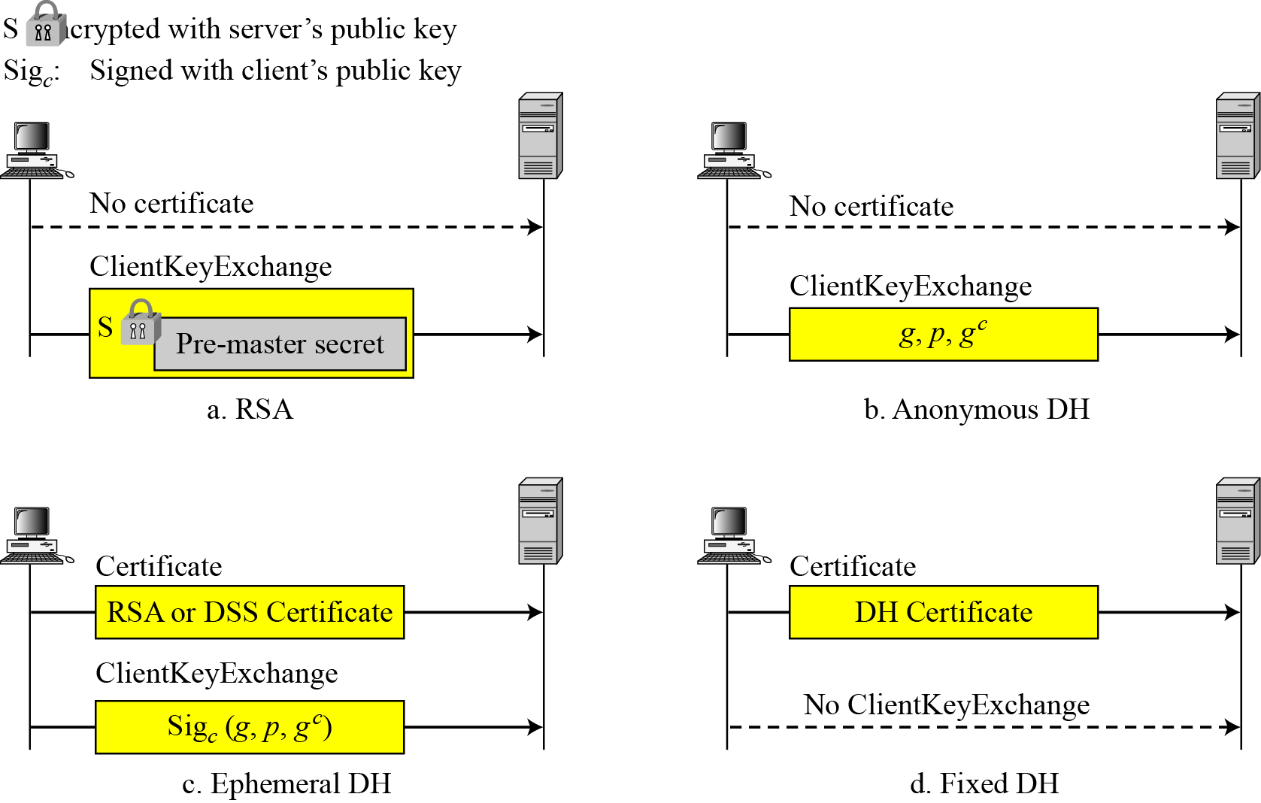
17.2.1 Continued
Figure 17.18 Four cases in Phase III
17.<number>

Slide 40
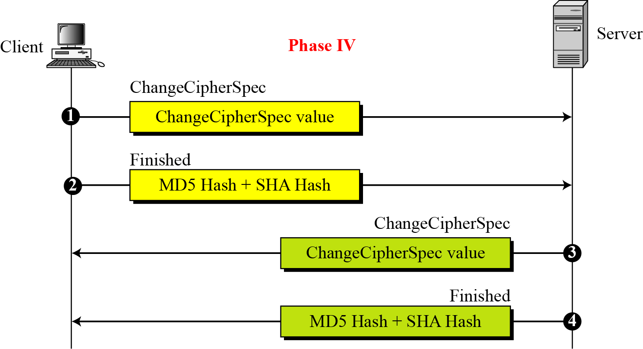
17.2.1 Continued
Figure 17.19 Phase IV of Handshake Protocol
17.<number>

Slide 41
17.2.1 Continued
Note
After Phase IV, the client and server are ready to exchange data.
17.<number>

Slide 42
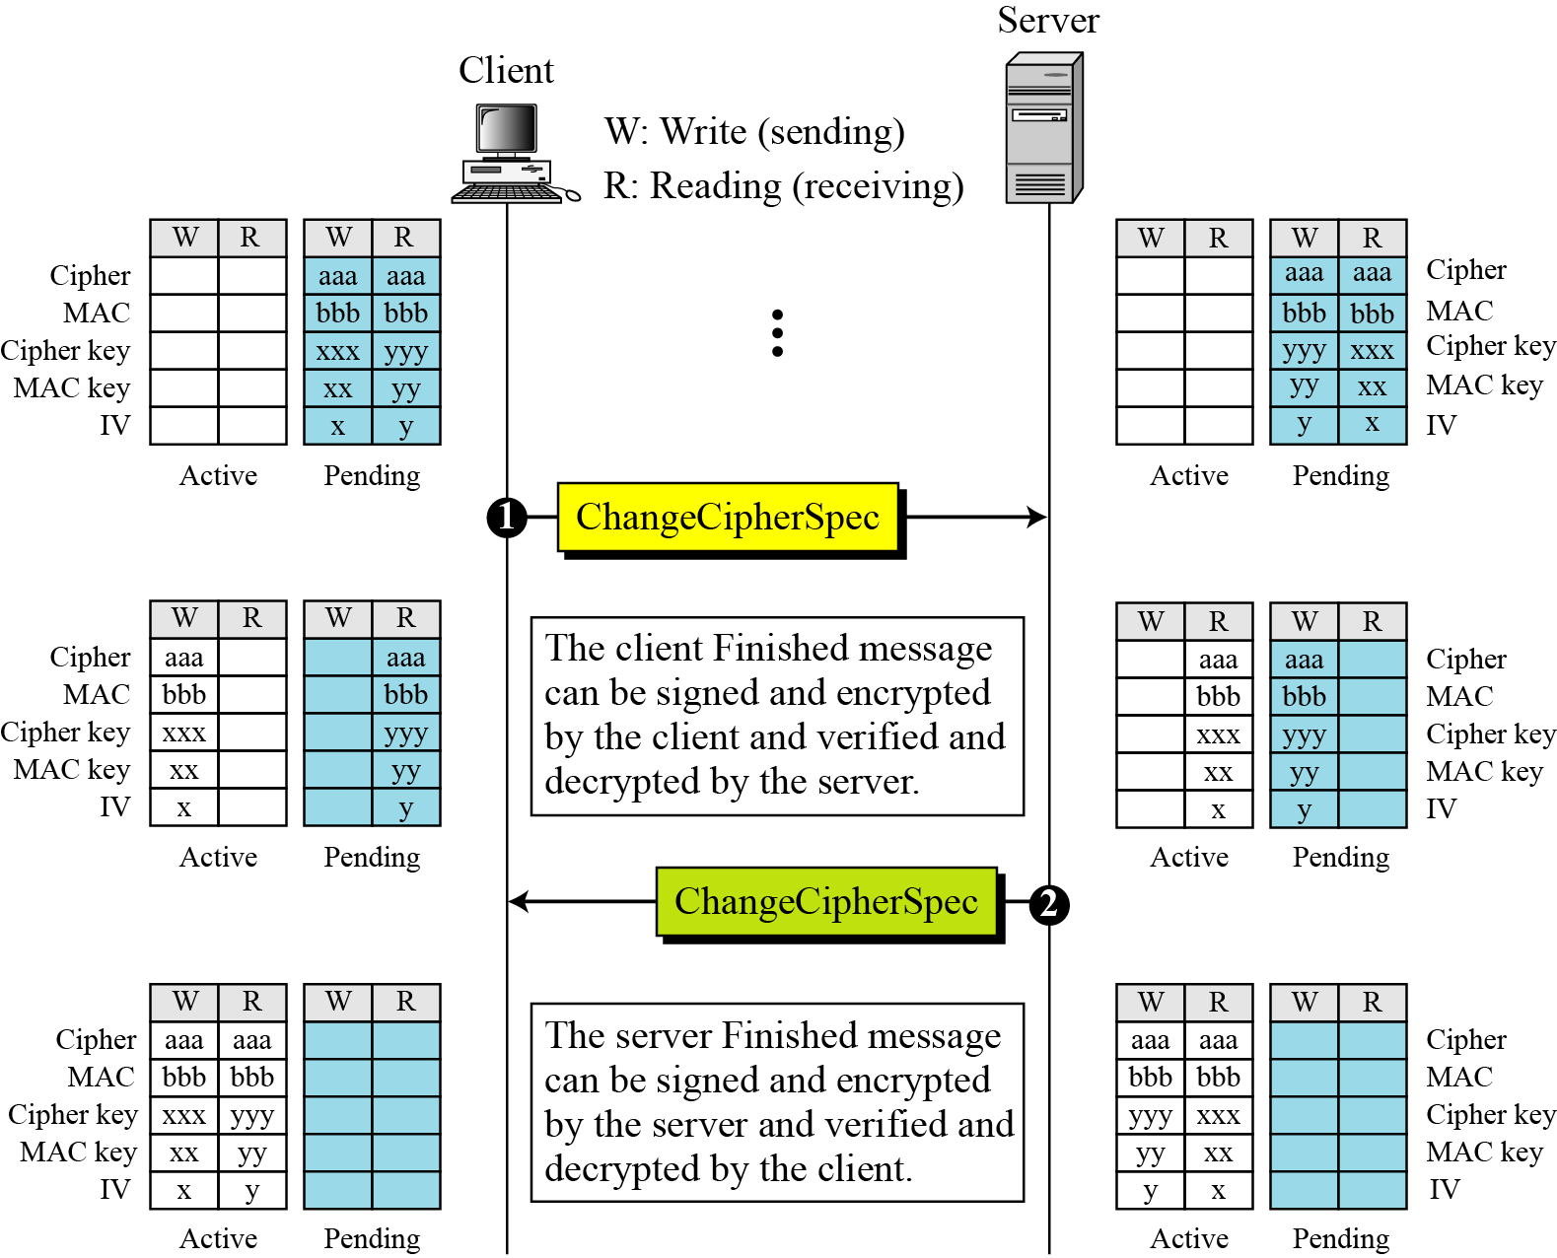
17.2.2 ChangeCipherSpec Protocol
Figure 17.20 Movement of parameters from pending
state to active state
17.<number>

Slide 43
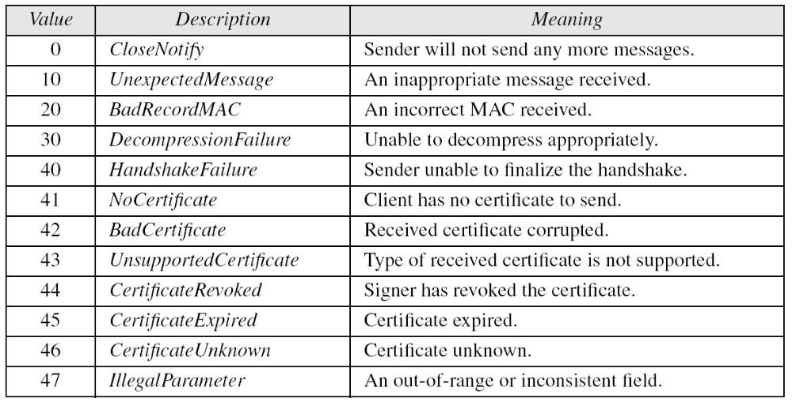
17.2.3 Alert Protocol
Table 17.4 Alerts defined for SSL
17.<number>

Slide 44
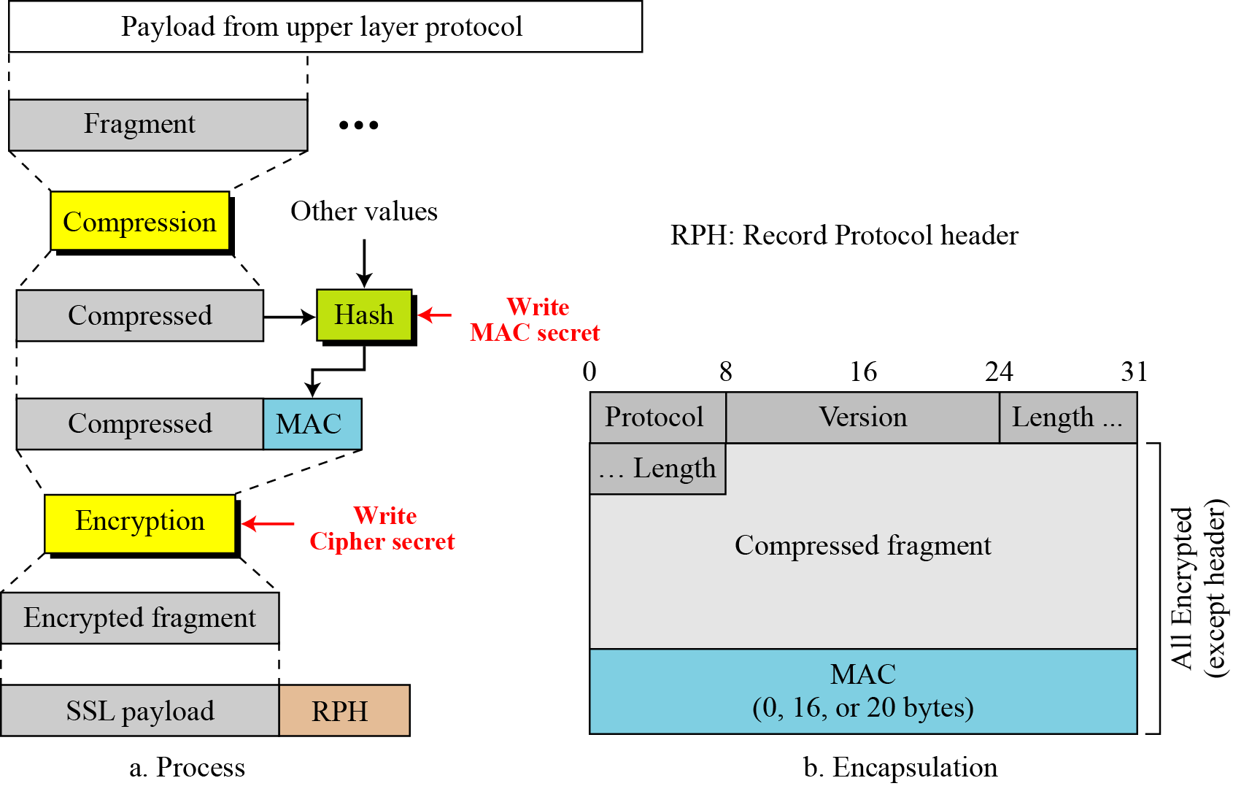
17.2.4 Record Protocol
Figure 17.21 Processing done by the Record Protocol
17.<number>

Slide 45
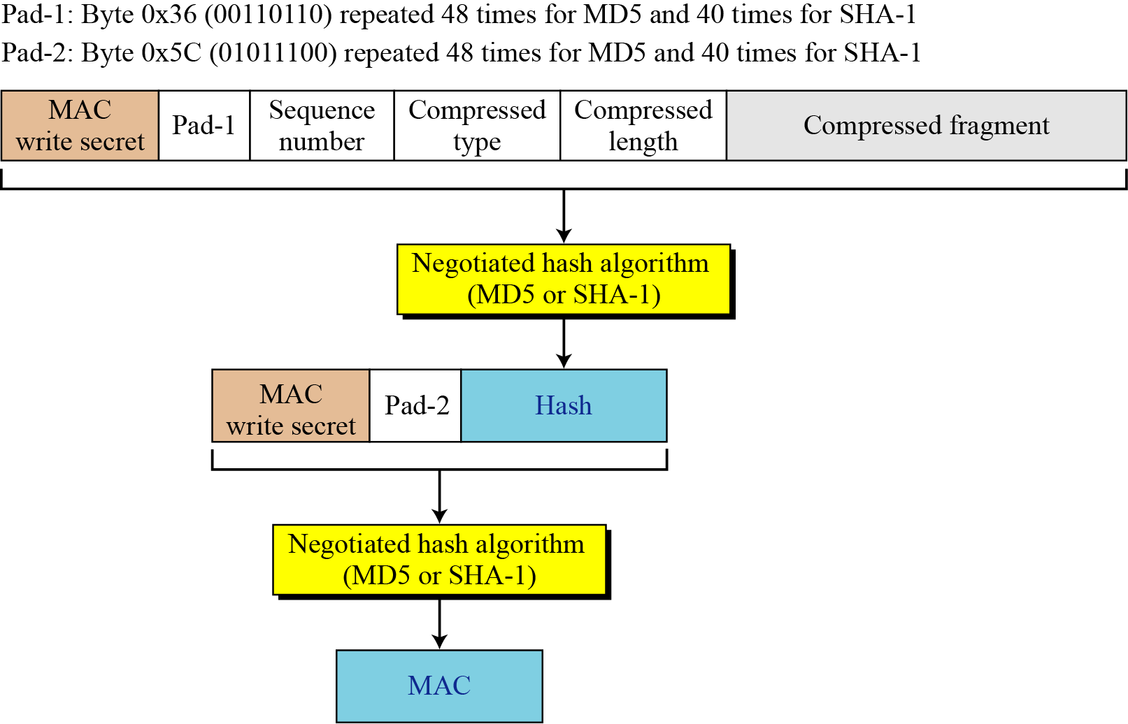
17.2.4 Continued
Figure 17.22 Calculation of MAC
17.<number>

Slide 46
17-3 SSL MESSAGE FORMATS
As we have discussed, messages from three protocols and data from the application layer are encapsulated in the Record Protocol messages.
Topics discussed in this section:
17.3.1 ChangeCipherSpec Protocol
17.3.2 Alert Protocol
17.3.3 Handshake Protocol
17.3.4 Application Data
17.<number>

Slide 47
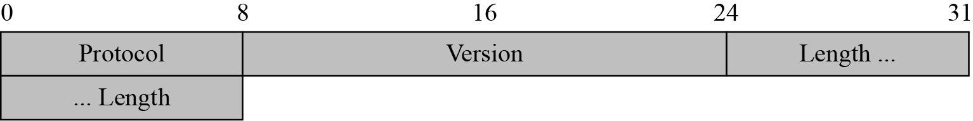
17.3 Continued
Figure 17.23 Record Protocol general header
17.<number>

Slide 48
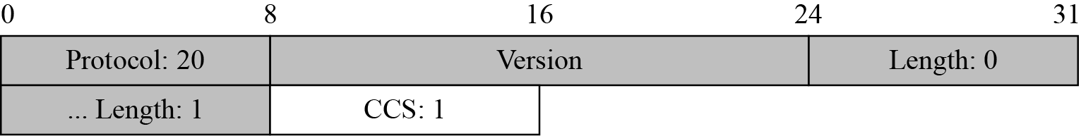
17.3.1 ChangeCipherSpec Protocol
Figure 17.24 ChangeCipherSpec message
17.<number>

Slide 49
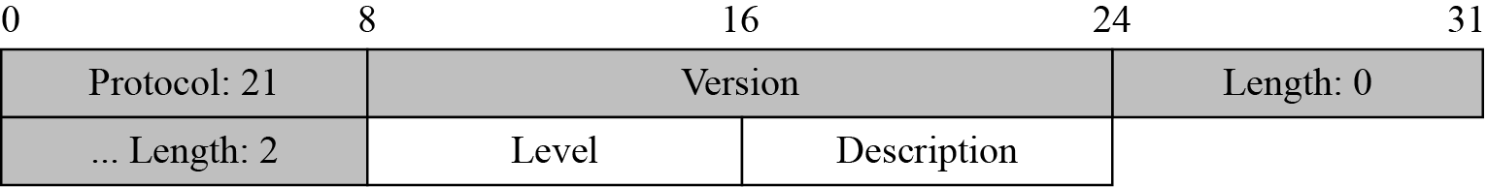
17.3.2 Alert Protocol
Figure 17.25 Alert message
17.<number>

Slide 50
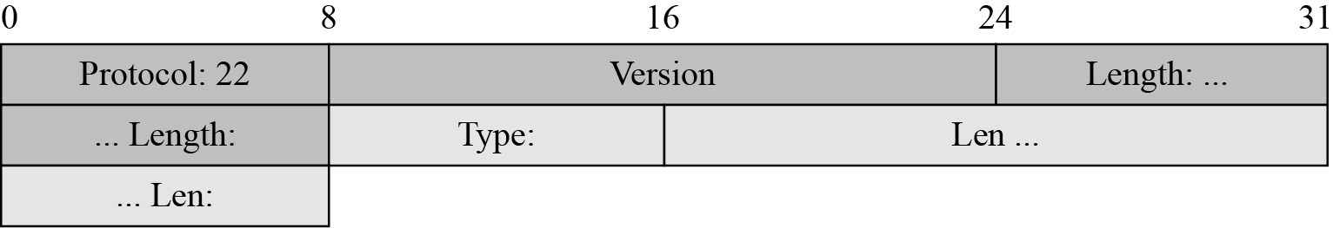
17.3.3 Handshake Protocol
Figure 17.26 Generic header for Handshake Protocol
17.<number>

Slide 51
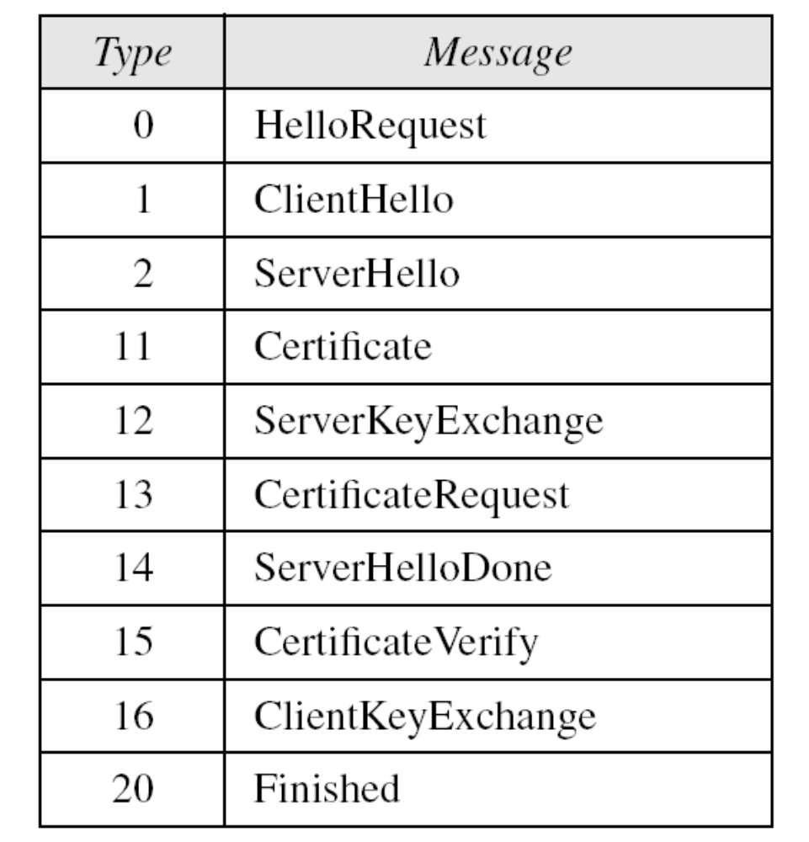
17.3.3 Continued
Table 17.5 Types of Handshake messages
17.<number>

Slide 52
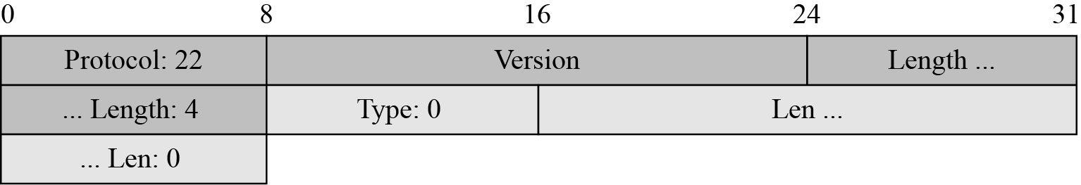
17.3.3 Continued
Figure 17.27 Virtual tributary types
17.<number>

Slide 53
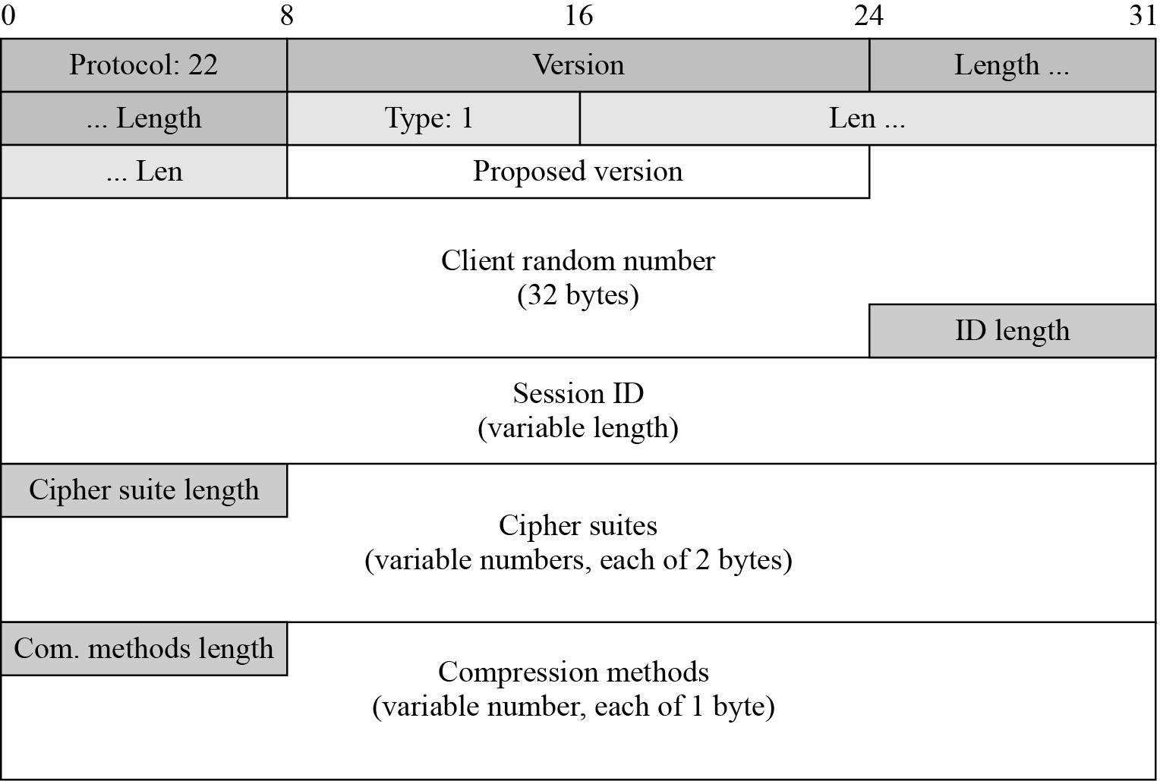
17.3.3 Continued
Figure 17.28 ClientHello message
17.<number>

Slide 54
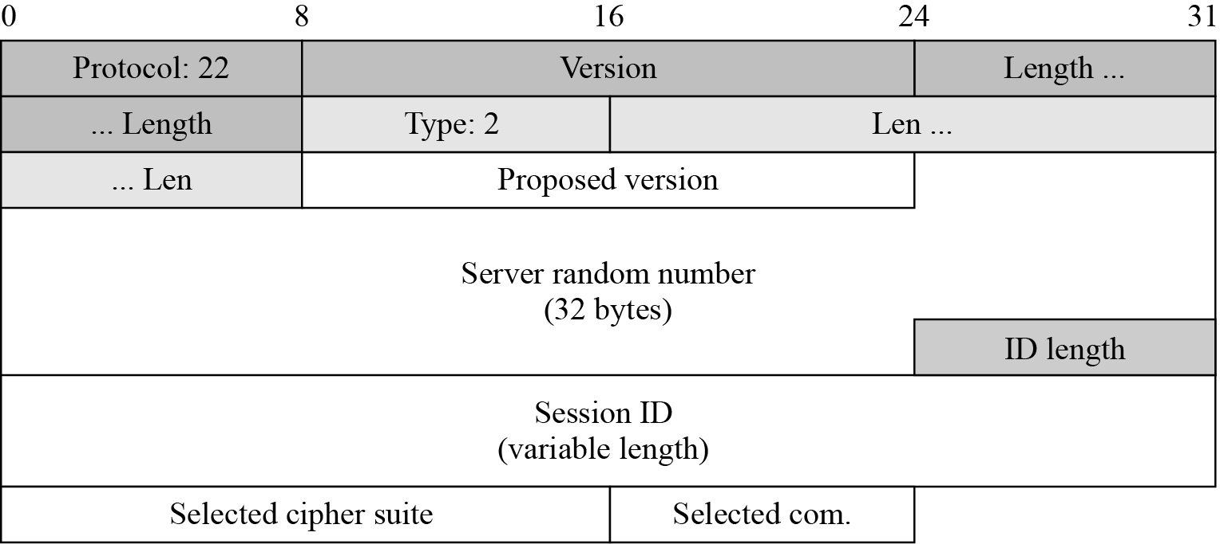
17.3.3 Continued
Figure 17.29 ServerHello message
17.<number>

Slide 55
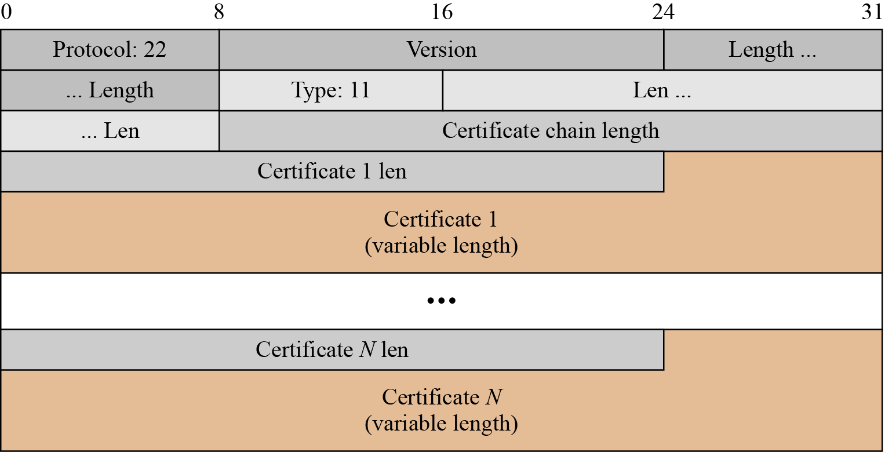
17.3.3 Continued
Figure 17.30 Certificate message
17.<number>

Slide 56
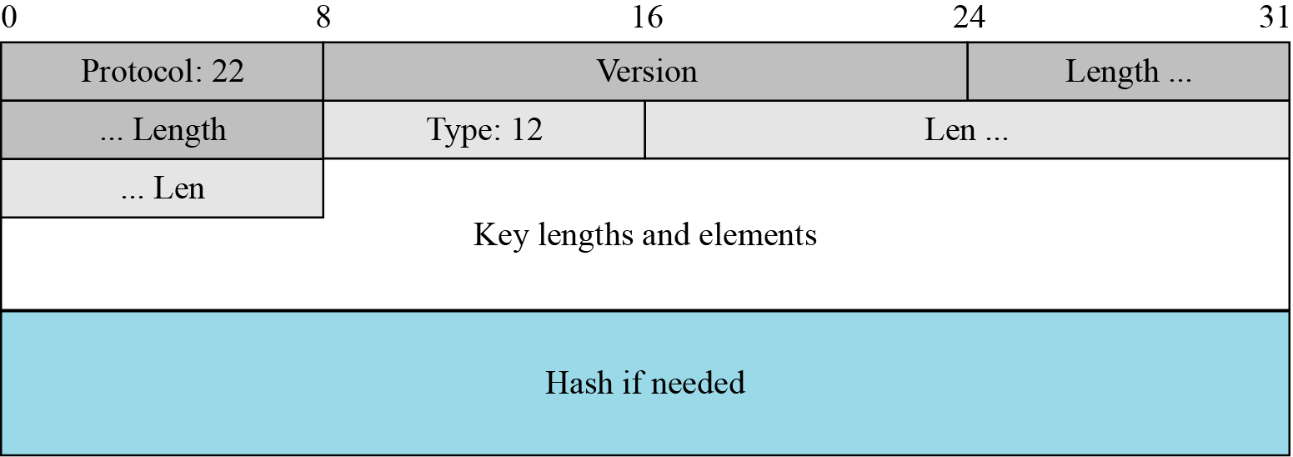
17.3.3 Continued
Figure 17.31 ServerKeyExchange message
17.<number>

Slide 57
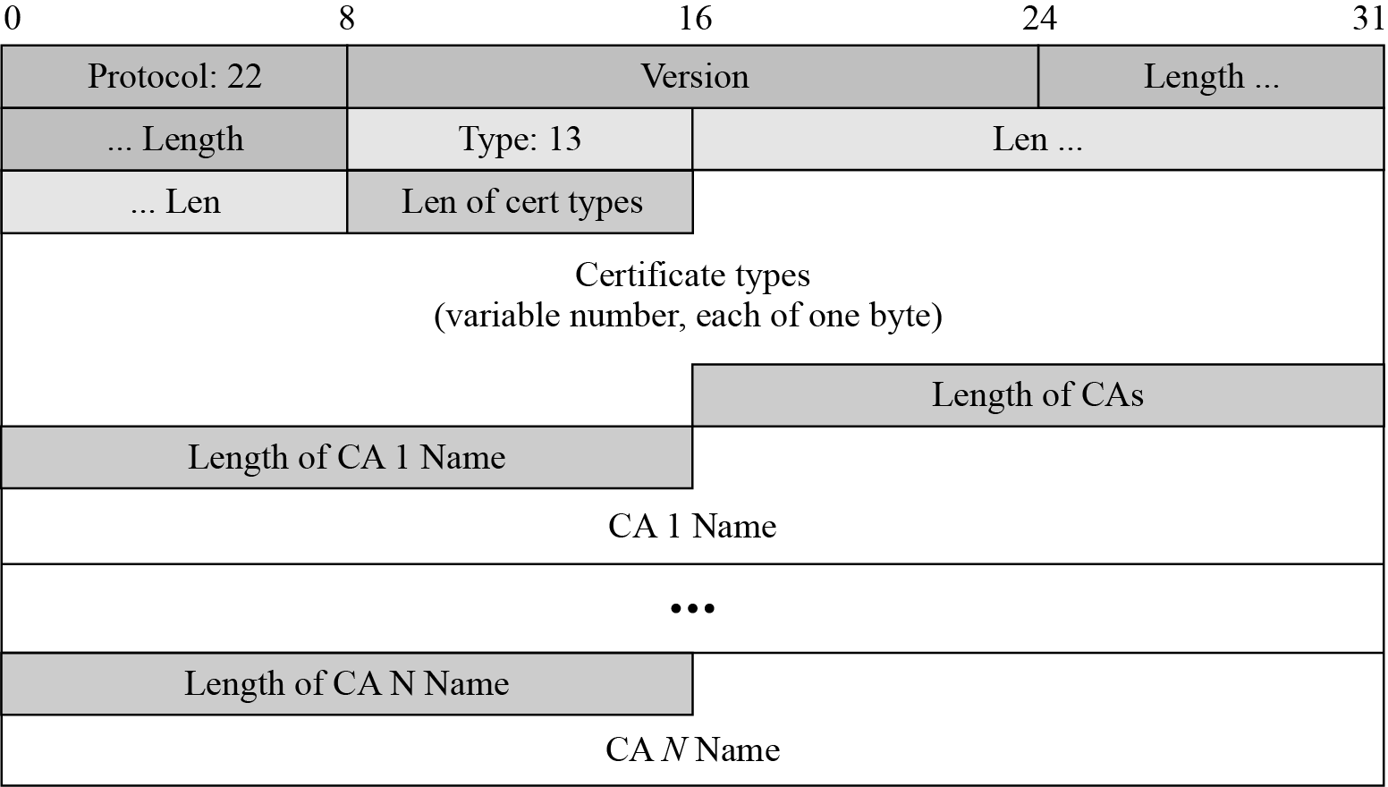
17.3.3 Continued
Figure 17.32 CertificateRequest message
17.<number>

Slide 58
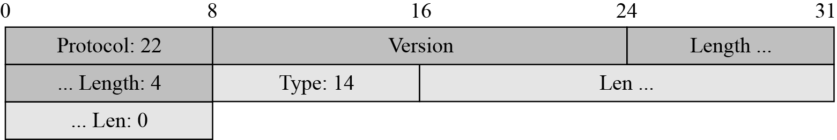
17.3.3 Continued
Figure 17.33 ServerHelloDone message
17.<number>

Slide 59
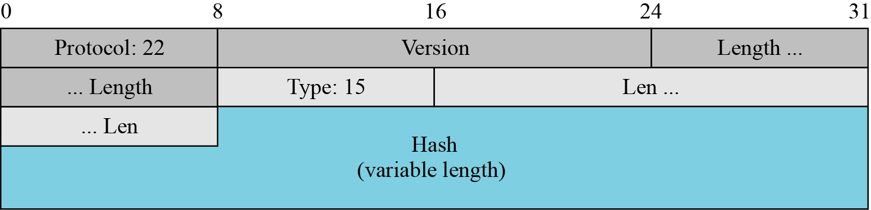
17.3.3 Continued
Figure 17.34 CertificateVerify message
17.<number>

Slide 60
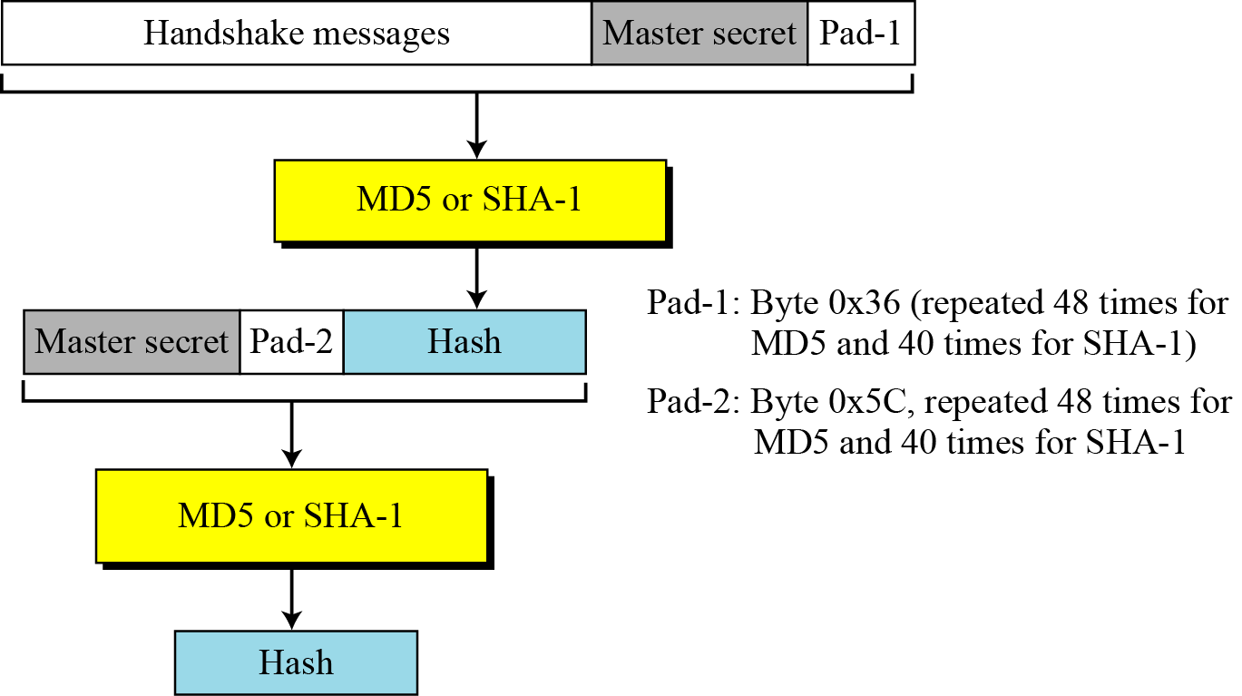
17.3.3 Continued
Figure 17.35 Hash calculation for CertificateVerify message
17.<number>

Slide 61
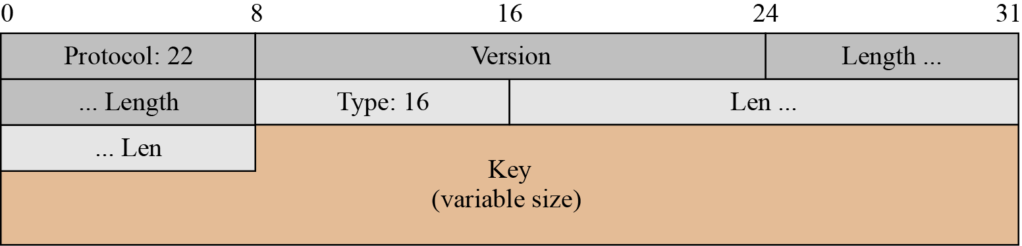
17.3.3 Continued
Figure 17.36 ClientKeyExchange message
17.<number>

Slide 62
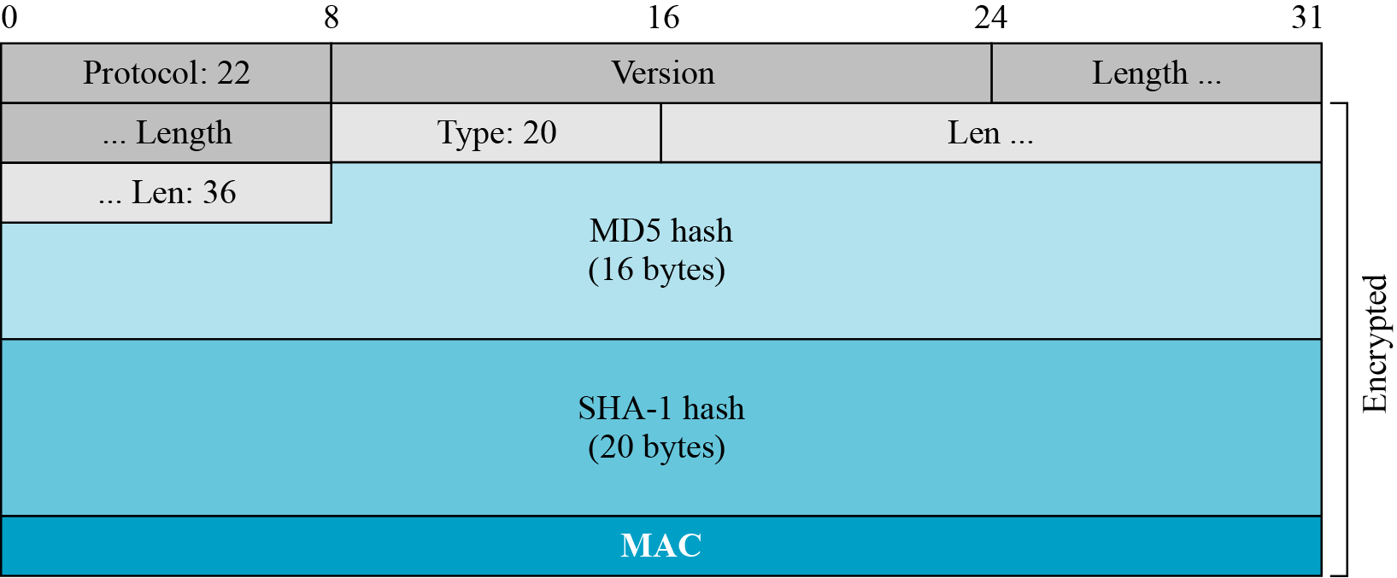
17.3.3 Continued
Figure 17.37 Finished message
17.<number>

Slide 63
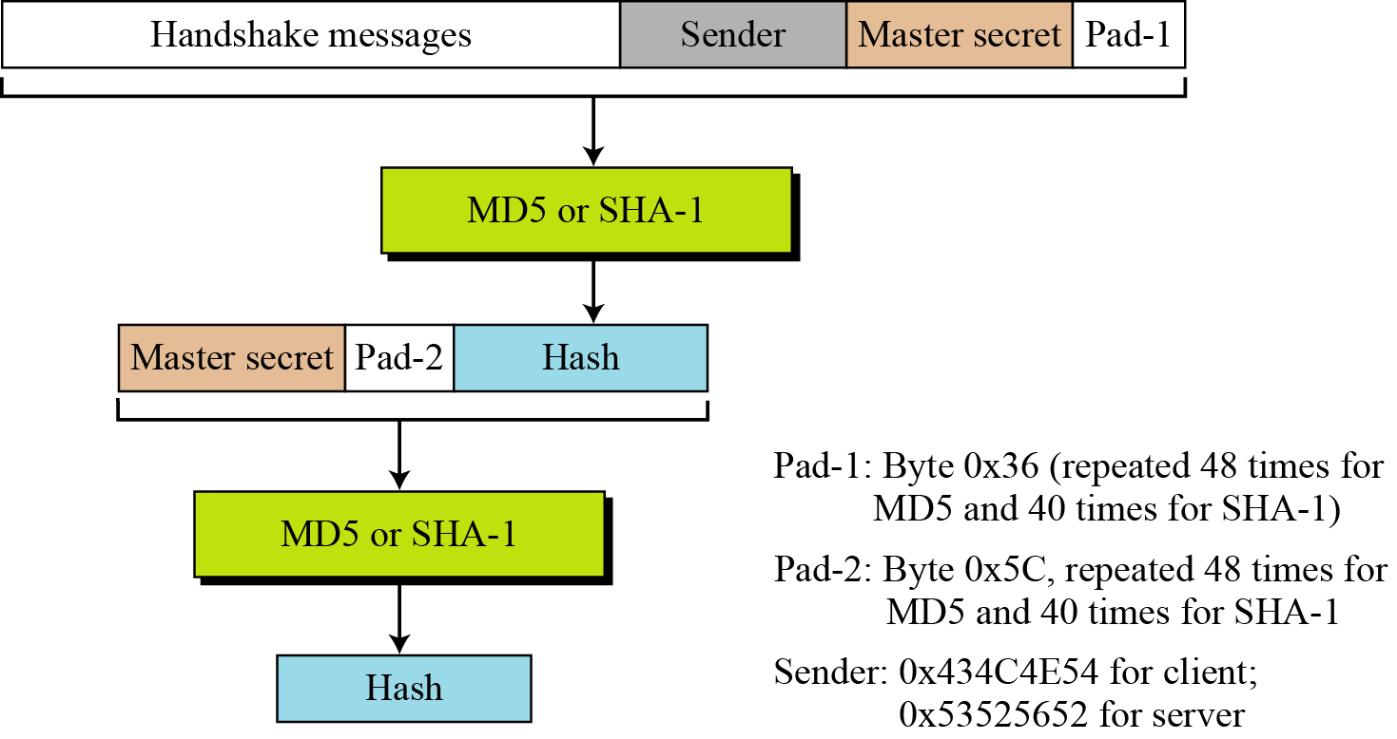
17.3.3 Continued
Figure 17.38 Hash calculation for Finished message
17.<number>

Slide 64
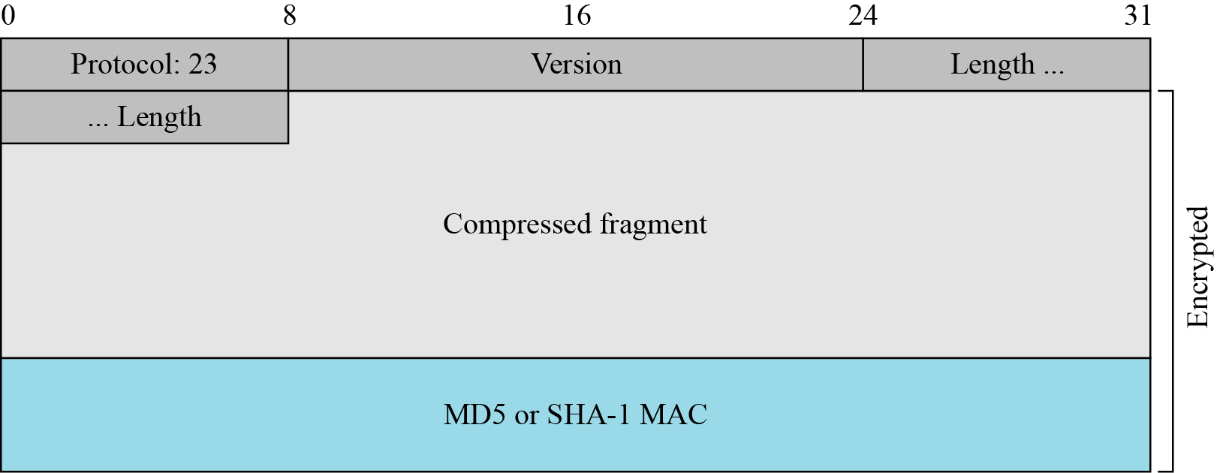
17.3.3 Application Data
Figure 17.39 Record Protocol message for application data
17.<number>

Slide 65
17-4 Transport Layer Security (TLS)
The Transport Layer Security (TLS) protocol is the IETF standard version of the SSL protocol. The two are very similar, with slight differences.
Topics discussed in this section:
17.4.1 Version
17.4.2 Cipher Suite
17.4.3 Generation of Cryptographic Secrets
17.4.4 Alert Protocol
17.4.5 Handshake Protocol
17.4.6 Record Protocol
17.<number>

Slide 66
17.4.1 Version
The first difference is the version number (major and minor). The current version of SSL is 3.0; the current version of TLS is 1.0. In other words, SSLv3.0 is compatible with TLSv1.0.
17.<number>

Slide 67
17.4.2 Cipher Suite
Another minor difference between SSL and TLS is the lack of support for the Fortezza method. TLS does not support Fortezza for key exchange or for encryption/decryption. Table 17.6 shows the cipher suite list for TLS (without export entries).
17.<number>

Slide 68
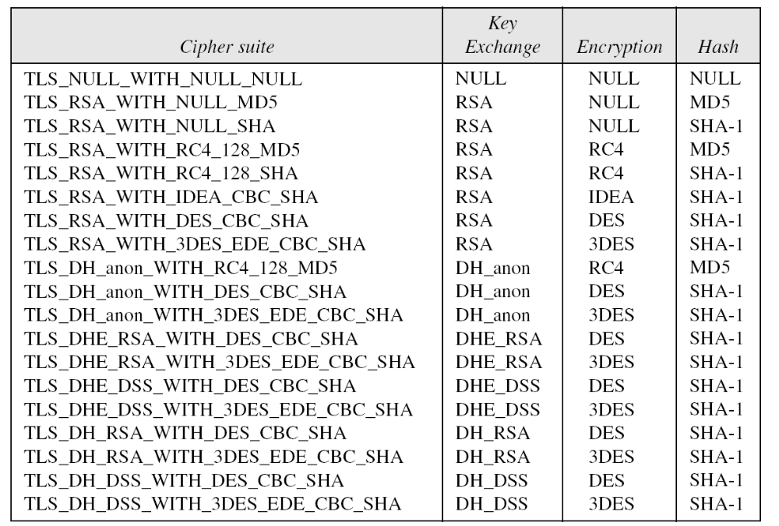
17.4.2 Continued
Table 17.6 Cipher Suite for TLS
17.<number>

Slide 69
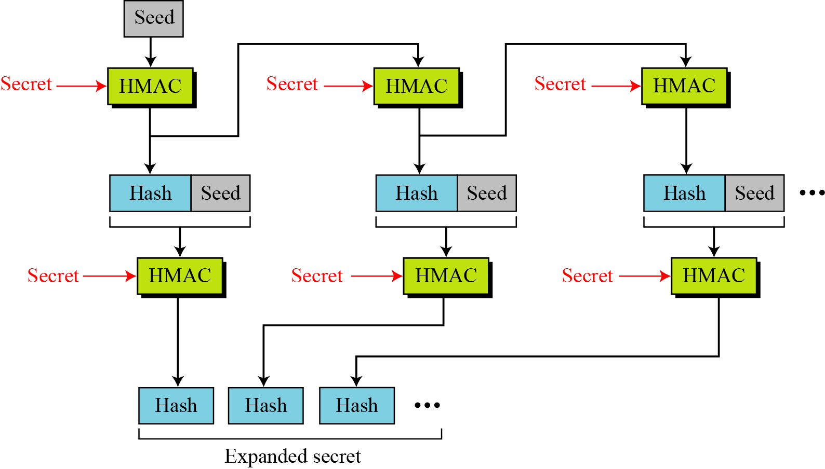
17.4.3 Generation of Cryptographic Secrets
Figure 17.40 Data-expansion function
17.<number>

Slide 70
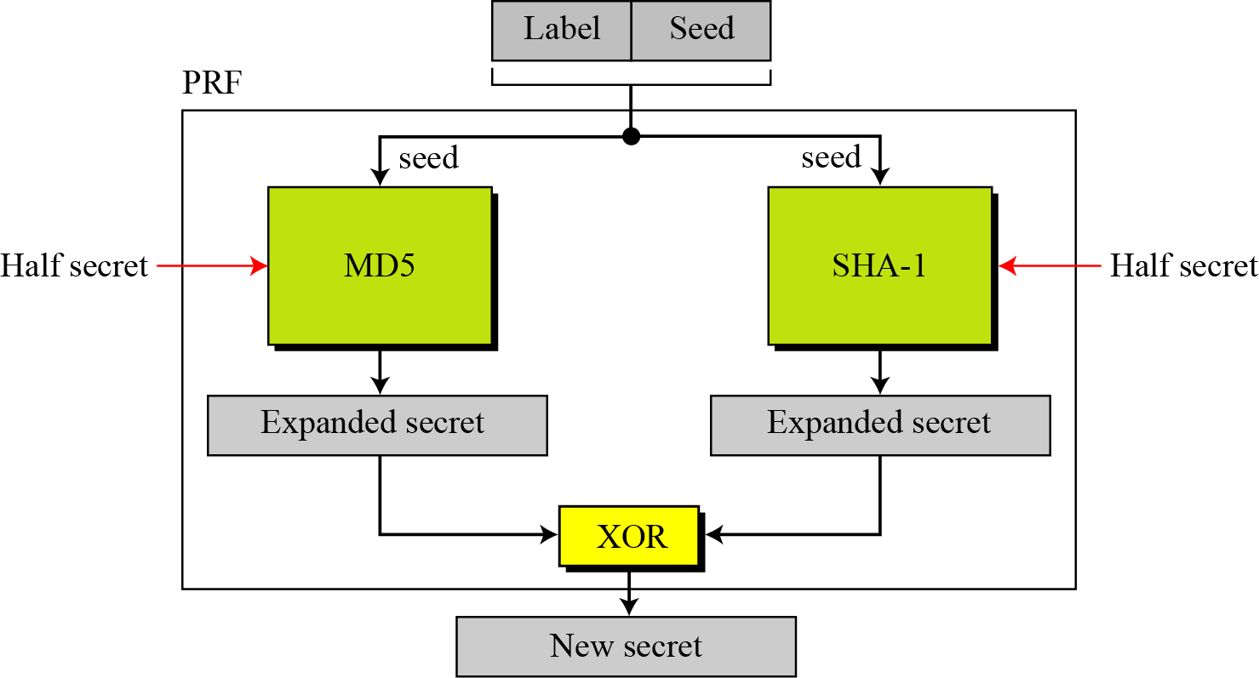
17.4.3 Continued
Figure 17.41 PRF
17.<number>

Slide 71
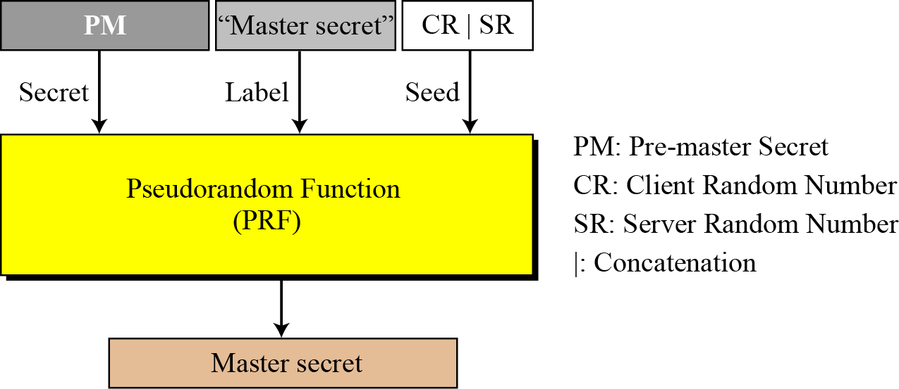
17.4.3 Continued
Figure 17.42 Master secret generation
17.<number>

Slide 72
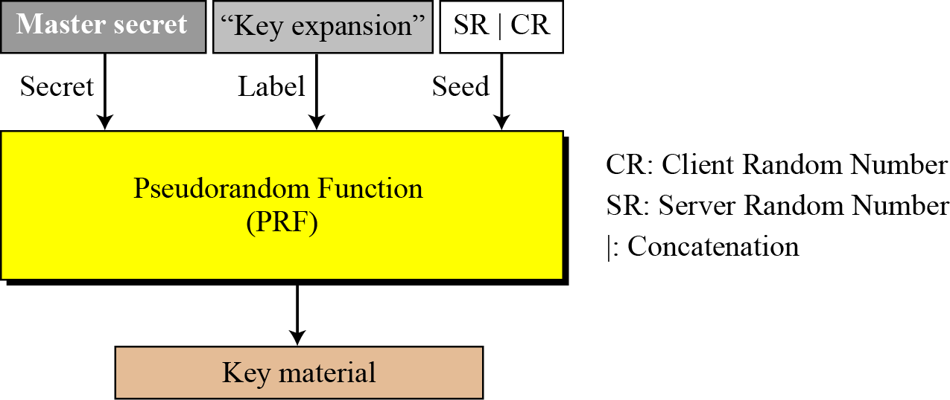
17.4.3 Continued
Figure 17.43 Key material generation
17.<number>

Slide 73
17.4.4 Alert Protocol
TLS supports all of the alerts defined in SSL except for NoCertificate. TLS also adds some new ones to the list. Table 17.7 shows the full list of alerts supported by TLS.
17.<number>

Slide 74
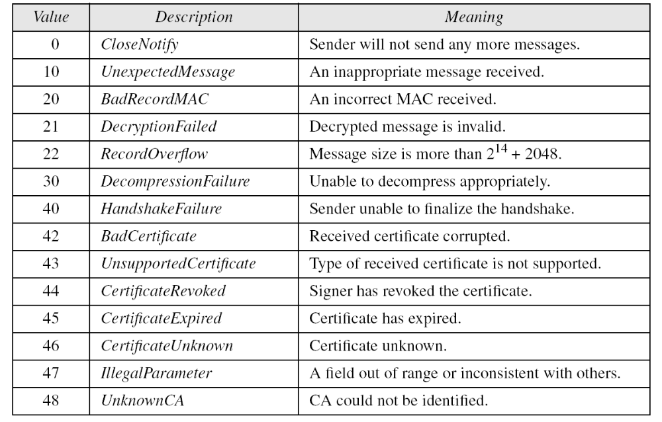
17.4.4 Continued
Table 17.7 Alerts defined for TLS
17.<number>

Slide 75

17.4.5 Handshake Protocol
Figure 17.44 Hash for CertificateVerify message in TLS
17.<number>

Slide 76

17.4.5 Continued
Figure 17.45 Hash for Finished message in TLS
17.<number>

Slide 77

17.4.6 Record Protocol
Figure 17.46 HMAC for TLS
17.<number>

